Slide 1
Presents
Inorbit Mall Hyderabad
Arch Flex

Slide 2
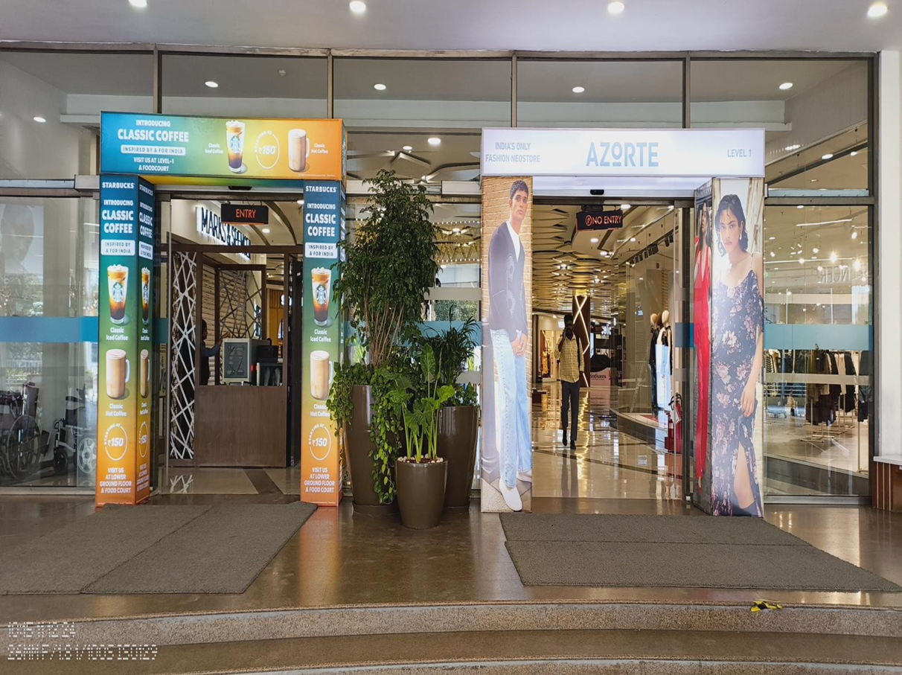
Arch Flex 1
LOCATION | DIMENSION | PRICE
Lower Ground Floor | 1.6(W) x 9.4(H) | 2,05000 P/M

Slide 3
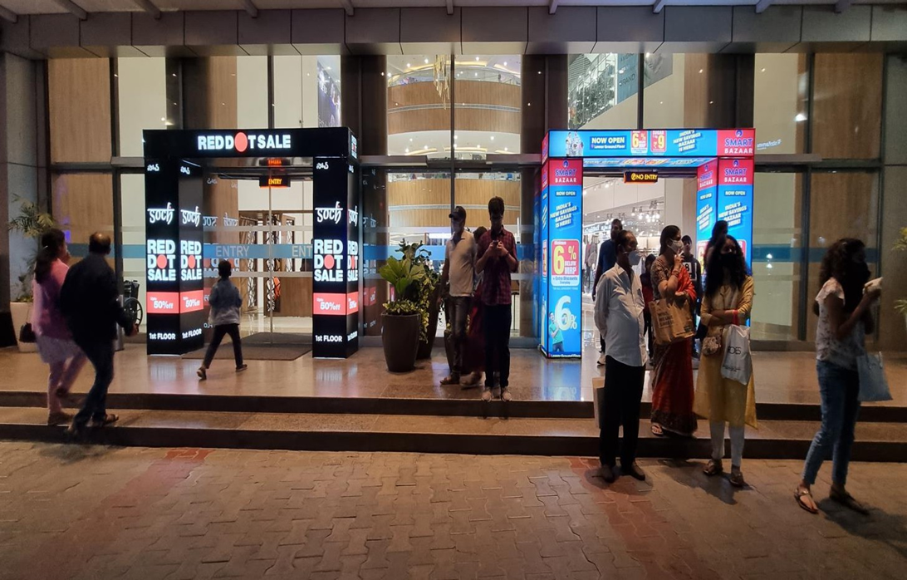
Arch Flex 2
LOCATION | DIMENSION | PRICE
Upper Ground Floor | 1.6(W) x 9.4(H) | 182000 P/M

Slide 4
WHERE CAN YOU FIND US?
Come See Us
Rukmini Knowledge Park Kattigenahalli, Yelahanka, Bellahalli Main Road,
Srinivasa Nagar, Bengaluru, Karnataka 560064
Reach Our Inbox contact@gingermediagroup.com
Chitter Chatter
Chat with Us 24/7
Say Hello
+91 990 247 8800
Thank you

